Slide 1


WELCOME TO OUR CLASS

Slide 2

Where do you live? Can you tell me about your village?
Look at these pictures then answer:
1. Is this your village?
2. List these names of the village.

Slide 3
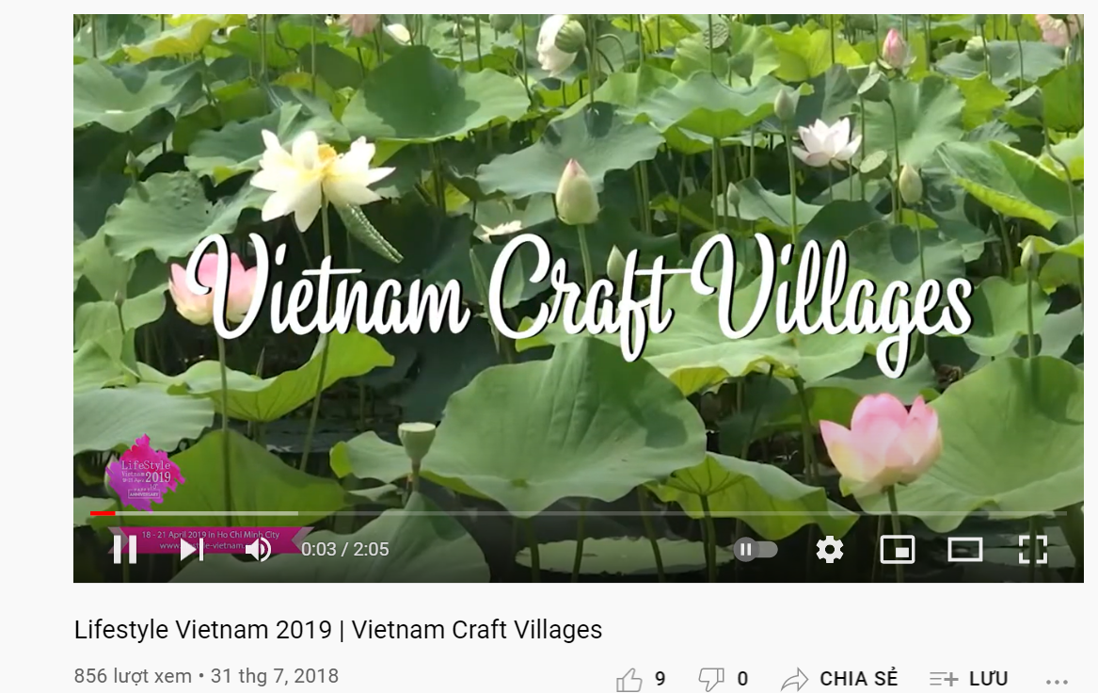
https://www.youtube.com/watch?v=fHQ1Mt8Vqhk

Slide 4
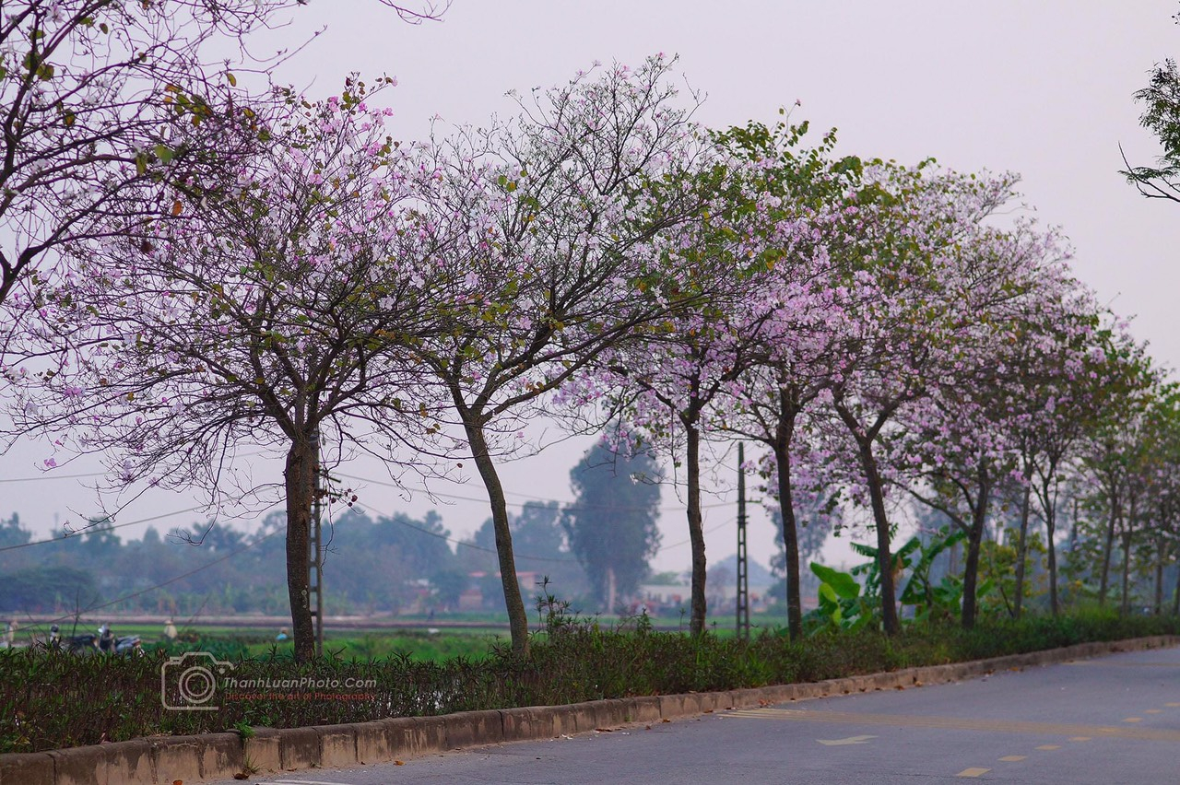
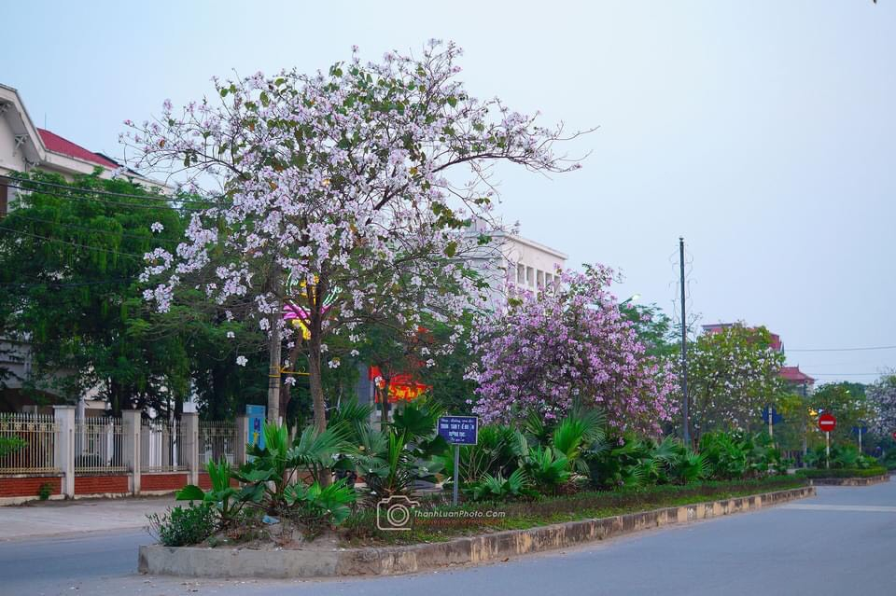
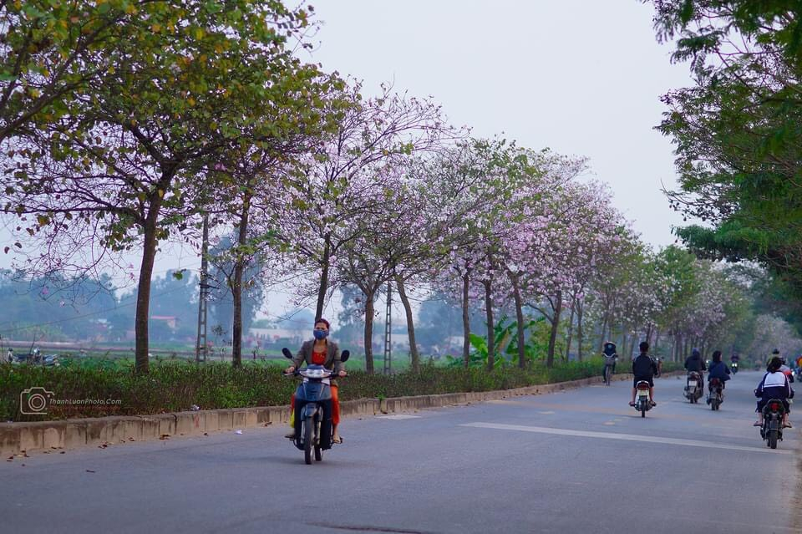
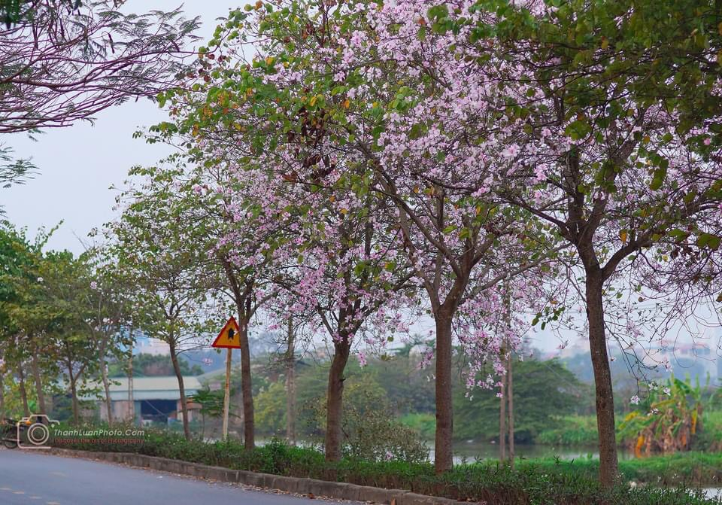

Slide 5

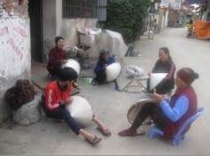
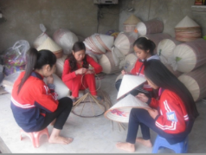

Slide 6
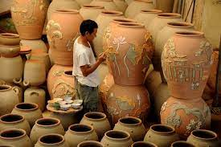
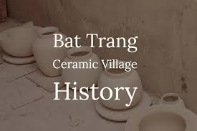
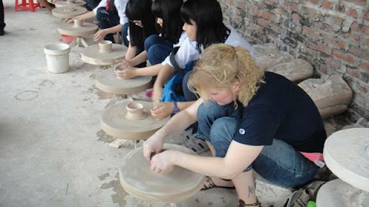
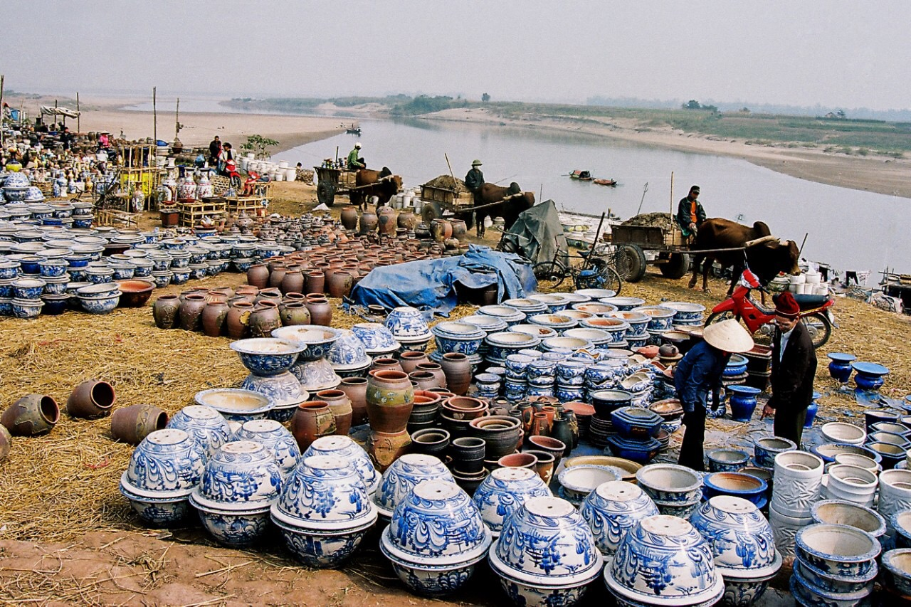

Slide 7

1. is this your village?
2. list these names of the village.
Well done, we have seen Vinh Thinh village and Bat Trang village.
We call they are local enviroment.
So what is ‘local enviroment’ mean?
Let’s start our lesson today.

Slide 8
Unit 1: Local enviroment
Lesson 1: Getting started
A visit to a traditional craft village

Slide 9
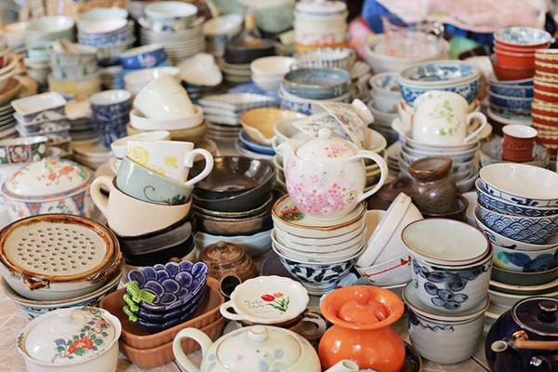
Pottery: đồ gốm
1. New words:

Slide 10
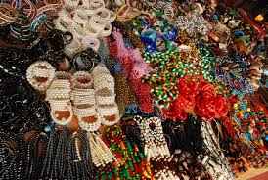
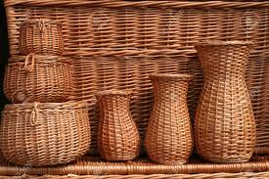
Handicraft : đồ thủ công

Slide 11
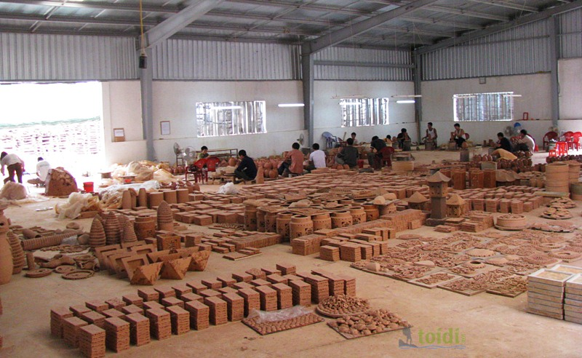
Workshop : xưởng làm việc

Slide 12
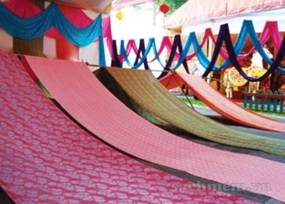
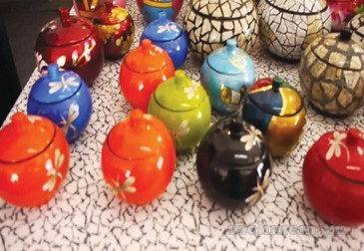
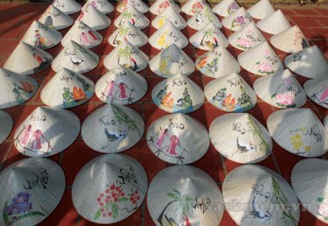
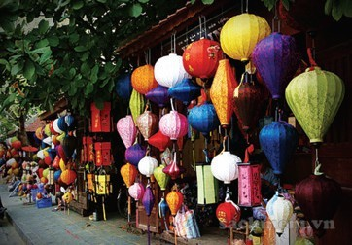
silk
lacquerware
/ˈlækəweə(r)/
conical hats
lanterns

Slide 13

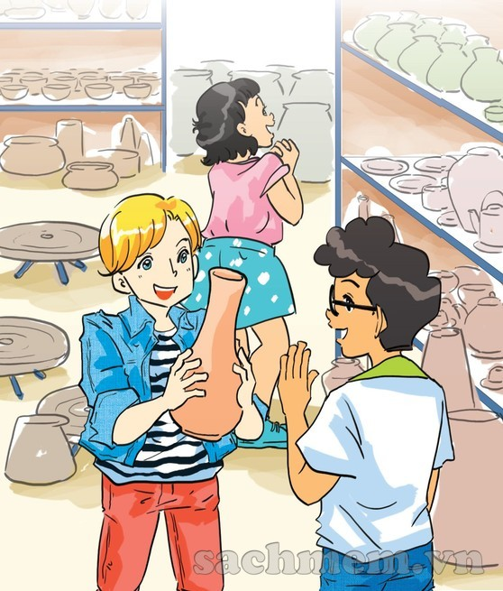
1. Who and what can you see in the picture?
2. Where are they?
3. What do you think the people in the picture are talking about?

Slide 14
1. Listen and read:
Nick: There are so many pieces of pottery here, Phong. Do your grandparents make all of them?
Phong: They can’t because we have lots of products. They make some and other people make the rest.
Nick: As far as I know, Bat Trang is one of the most famous traditional craft villages of Ha Noi, right?
Phong: Right. My grandmother says it’s about 700 years old.
Mi: Wow! When did your grandparents set up this workshop?

Slide 15
Phong: My great-grandparents started it, not my grandparents. Then my grandparents took over the business. All the artisans here are my aunts, uncles, and cousins.
Mi: I see. Your village is also a place of interest of Ha Noi, isn’t it?
Phong: Yes. People come here to buy things for their house. Another attraction is they can make pottery themselves in workshops.
Phong: Yes. People come here to buy things for their house. Another attraction is they can make pottery themselves in workshops.

Slide 16
Nick: That must be a memorable experience.
Phong: In Viet Nam there are lots of craft villages like Bat Trang. Have you ever been to any others?
Mi: I’ve been to a conical hat making village in Hue!
Nick: Cool! This is my first one. Do you think that the various crafts remind people of a specific region?
Mi: Sure. It’s the reason tourists often choose handicrafts as souvenirs.
Phong: Let’s go outside and look round the village…

Slide 17
1.a. Can you find a word/phrase that means?
1. a thing which is skillfully made with your hands
2. start something (a business, an organization, etc.)
3. take control of something (a business, an organization, etc.)
4. people who do skilled work, making things with their hands
craft
set up
take over
artisans

Slide 18
1.a. Can you find a word/phrase that means?
5. an interesting or enjoyable place to go or thing to do
6. a particular place
7. make someone remember or think about something
8. walk around a place to see what is there
attraction
specific region
remind
look round

Slide 19
1.b. Answer the following questions by playing game
1. Where are Nick, Mi, and Phong?
2. How old is the village?
3. Who started Phong’s family workshop?
4. Why is the village a place of interest in Ha Noi?
5. Where is the craft village that Mi visited?
6. Why do tourists like to buy handicrafts as souvenirs?

Slide 20



3
4
5
6
2
1
7
LUCKY APPLE

Slide 21


3. Who started Phong’s family workshop?
=>His great-grandparents .

Slide 22


3
LUCKY APPLE

Slide 23

1. Where are Nick, Mi, and Phong?
=>They are at Phong’s grandparents’ workshop in Bat Trang.

Slide 24


6. Why do tourists like to buy handicrafts as souvenirs?
=>Because the handicrafts remind them of a specific region.

Slide 25
4. Why is the village a place of interest in Ha Noi?
=>Because people can buy things for their house and make pottery themselves there.

Slide 26

2. How old is the village?
=>It is about 700 years old.

Slide 27

5. Where is the craft village that Mi visited?
=> It is in Hue.

Slide 28
1.They are at Phong’s grandparents’ workshop in Bat Trang.
2.It is about 700 years old.
3.His great-grandparents did.
4.Because people can buy things for their house and make pottery themselves there.
5.It is in Hue.
6.Because the handicrafts remind them of a specific region.

Slide 29
E.silk
F. lacquerware
G. conical hats
H. lanterns

Slide 30
3. Complete the sentences with the words/ phrases from 2
conical hat
1. The birthplace of the famous bai tho ……………….
is Tay Ho village in Hue.
2. If you go to Hoi An on the 15th of each lunar month, you can enjoy the lights of many beautiful ……………………….
3. Van Phuc village in Ha Noi produces different types of ……………. products such as cloth, scarves, ties, and dresses.
lanterns
silk

Slide 31
3. Complete the sentences with the words/ phrases from 2
4. On the Tet holiday, many Hanoians go to Dong Ho village to buy folk……………….. .
5. …………… products of Bau Truc, such as pots and vases, have the natural colours typical of Champa culture in Ninh Thuan.
6. Going to Non Nuoc marble village in Da Nang, we’re impressed by a wide variety of …………………………from Buddha statues to bracelets.
paintings
Pottery
marble sculptures

Slide 32
4. Quiz: WHAT IS THE PLACE OF INTERESTS?
a. Work in pairs to do the quiz.
1. People go to this area to walk, play, and relax.
2. It is a place where objects of artistic, cultural, historical, of scientific interest are kept and shown.
3. People go to this place to see animals.
4. It is an area of sand, or small stones, beside the sea or a lake.
5. It is a beautiful and famous place in the countryside.
1.park
2. museum
3. zoo
4. beach
5. beauty spot

Slide 33
- Learn by heart the new words - Prepare for the next lesson
Homework

